Slide 1

Monitoring in Azure

Slide 2

Overview
Super-quick Azure Monitor Overview
Azure Monitoring Demo
Intro to the Sample App
Monitoring the App
Lessons Learned

Slide 3
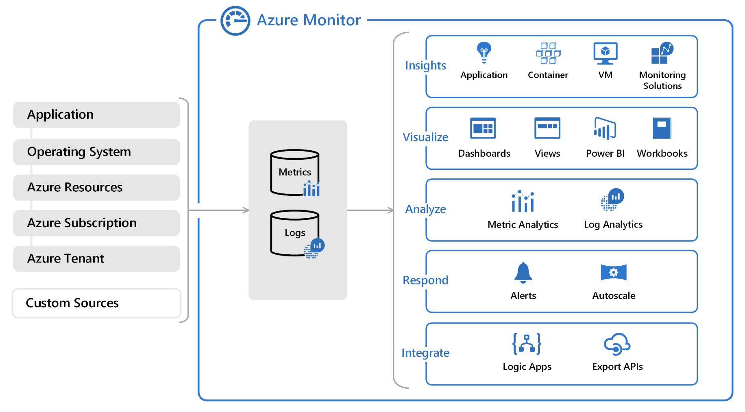
Super-quick Azure Monitor Overview
See https://docs.microsoft.com/en-us/azure/azure-monitor/overview

Slide 4

Super-quick Azure Monitor Overview
Metrics
Application Insights
Availability Tests
Dashboards
Alerts
Diagnostic Logs
Service Health

Slide 5
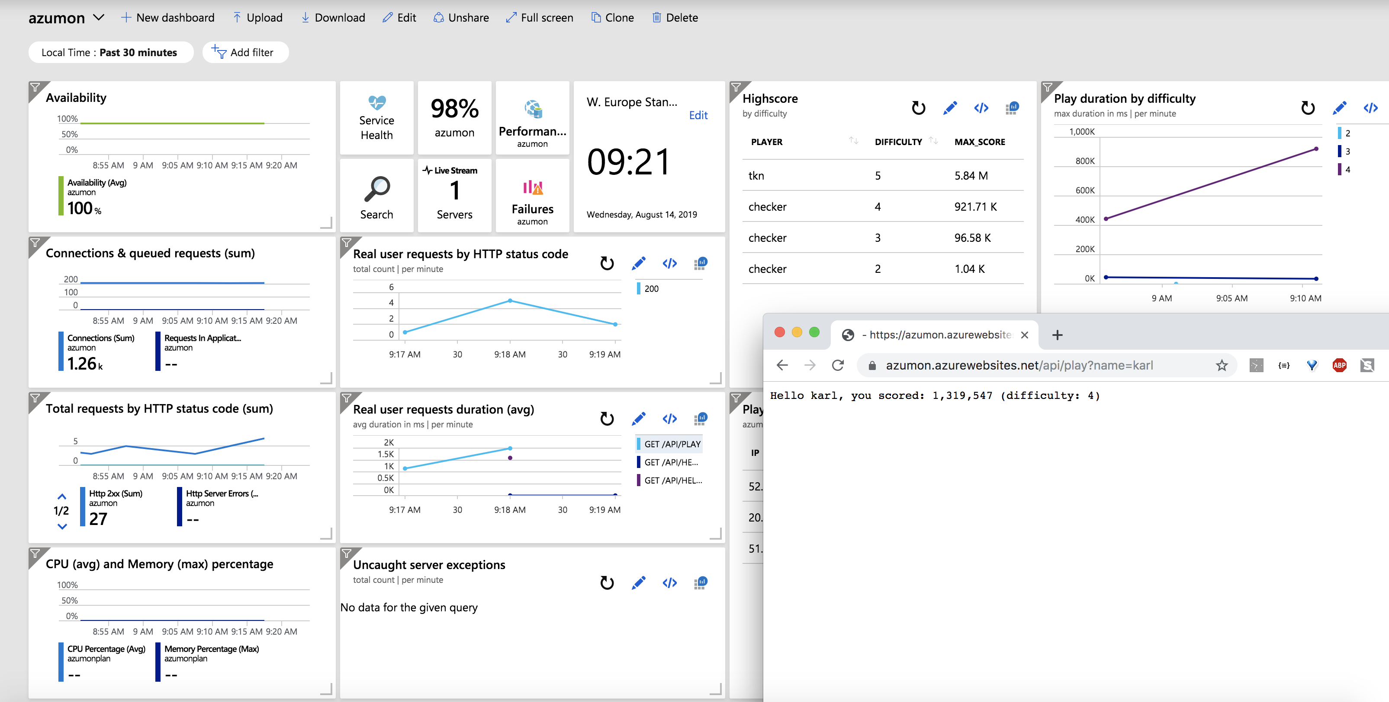
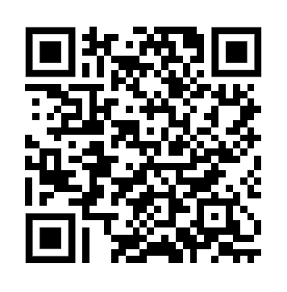
Azure Monitoring Demo!
https://github.com/tknerr/zdod19-azure-monitoring-demo

Slide 6

Lessons Learned
Learning Kusto Query Language is well invested
Deciding what to put on the dashboard is the hardest part
Once you have it in Metrics / Logs everything else is easy
Enable Diagnostic Logs where possible
Automate everything (and separate data from logic)
Beware: monitorability might be dependent on pricing tier
Dashboard annoyances (colors, widgets, timechooser)
Azure (Premier) Support...

Slide 7

Automation Tipps
You will need to automate it!!!
Create resources via Azure Portal GUI -> export -> refine
Know the Azure Resource Explorer
Know the docs / how to google for them
Use Resource Iterators to keep ARM templates clean
Separate logic from data

Slide 8

Resources
Demo Repository: https://github.com/tknerr/zdod19-azure-monitoring-demo
A reusable “Monitoring Concept for Azure Projects”: https://confluence.zuehlke.com/display/ZTOPAZU/A+Reusable+Monitoring+Concept+for+Azure+Projects
Kusto Query Language: https://docs.microsoft.com/en-us/azure/kusto/query/

Slide 9
Thank You! ☺
…and let’s continue the discussion here:
Torben Knerr
torben.knerr@zuehlke.com
@tknerr_de
http://github.com/tknerr
http://linkedin.com/in/tknerr

